Slide 1
Chapter 12
File Management
Operating Systems:
Internals and Design Principles
Nineth Edition
By William Stallings
Notes:
“Operating Systems: Internal and Design Principles”, 7/e, by William Stallings, Chapter 12 “File Management”.

Slide 2
Files
Data collections created by users
The File System is one of the most important parts of the OS to a user
Desirable properties of files:
Long-term existence
files are stored on disk or other secondary storage and do not disappear when a user logs off
Sharable between processes
files have names and can have associated access permissions that permit controlled sharing
Structure
files can be organized into hierarchical or more complex structure to reflect the relationships among files
Notes:
From the user’s point of view, one of the most important parts of an operating
system is the file system. The file system provides the resource abstractions typically
associated with secondary storage. The file system permits users to create data
collections, called files, with desirable properties, such as:
• Long-term existence: Files are stored on disk or other secondary storage and
do not disappear when a user logs off.
• Sharable between processes: Files have names and can have associated access
permissions that permit controlled sharing.
• Structure: Depending on the file system, a file can have an internal structure
that is convenient for particular applications. In addition, files can be organized
into hierarchical or more complex structure to reflect the relationships
among files.

Slide 3
File Systems
Provide a means to store data organized as files as well as a collection of functions that can be performed on files
Maintain a set of attributes associated with the file
Typical operations include:
  Create
  Delete
  Open
  Close
  Read
  Write
Notes:
Any file system provides not only a means to store data organized as files, but
a collection of functions that can be performed on files. Typical operations include
the following:
• Create: A new file is defined and positioned within the structure of files.
• Delete: A file is removed from the file structure and destroyed.
• Open: An existing file is declared to be “opened” by a process, allowing the
process to perform functions on the file.
• Close: The file is closed with respect to a process, so that the process no longer
may perform functions on the file, until the process opens the file again.
• Read: A process reads all or a portion of the data in a file.
• Write: A process updates a file, either by adding new data that expands the
size of the file or by changing the values of existing data items in the file.
Typically, a file system maintains a set of attributes associated with the file.
These include owner, creation time, time last modified, access privileges, and so on.

Slide 4
File Structure
Four terms are commonly used when discussing files:
Field
Record
File
Database
Notes:
Four terms are in common use when discussing files:
• Field
• Record
• File
• Database

Slide 5
Structure Terms
Field
File
  basic element of data
  contains a single value
  fixed or variable length
  collection of similar records
  treated as a single entity
  may be referenced by name
  access control restrictions usually apply at the file level
Database
  collection of related data
  relationships among elements of data are explicit
  designed for use by a number of different applications
  consists of one or more types of files
Record
collection of related fields that can be treated as a unit by some application program
fixed or variable length
Notes:
A field is the basic element of data. An individual field contains a single value,
such as an employee’s last name, a date, or the value of a sensor reading. It is characterized
by its length and data type (e.g., ASCII string, decimal). Depending on the
file design, fields may be fixed length or variable length. In the latter case, the field
often consists of two or three subfields: the actual value to be stored, the name of
the field, and, in some cases, the length of the field. In other cases of variable-length
fields, the length of the field is indicated by the use of special demarcation symbols
between fields.
A record is a collection of related fields that can be treated as a unit by some
application program. For example, an employee record would contain such fields
as name, social security number, job classification, date of hire, and so on. Again,
depending on design, records may be of fixed length or variable length. A record
will be of variable length if some of its fields are of variable length or if the number
of fields may vary. In the latter case, each field is usually accompanied by a field
name. In either case, the entire record usually includes a length field.
A file is a collection of similar records. The file is treated as a single entity by
users and applications and may be referenced by name. Files have file names and
may be created and deleted. Access control restrictions usually apply at the file
level. That is, in a shared system, users and programs are granted or denied access
to entire files. In some more sophisticated systems, such controls are enforced at the
record or even the field level.
Some file systems are structured only in terms of fields, not records. In that
case, a file is a collection of fields.
A database is a collection of related data. The essential aspects of a database
are that the relationships that exist among elements of data are explicit and that the
database is designed for use by a number of different applications. A database may
contain all of the information related to an organization or project, such as a business
or a scientific study. The database itself consists of one or more types of files. Usually,
there is a separate database management system that is independent of the operating
system, although that system may make use of some file management programs.

Slide 6
File Management System Objectives
Meet the data management needs of the user
Guarantee that the data in the file are valid
Optimize performance
Provide I/O support for a variety of storage device types
Minimize the potential for lost or destroyed data
Provide a standardized set of I/O interface routines to user processes
Provide I/O support for multiple users in the case of multiple-user systems
Notes:
A file management system is that set of system software that provides services to
users and applications in the use of files. Typically, the only way that a user or application
may access files is through the file management system. This relieves the user
or programmer of the necessity of developing special-purpose software for each
application and provides the system with a consistent, well-defined means of controlling
its most important asset. [GROS86] suggests the following objectives for a
file management system:
• To meet the data management needs and requirements of the user, which include
storage of data and the ability to perform the aforementioned operations
• To guarantee, to the extent possible, that the data in the file are valid
• To optimize performance, both from the system point of view in terms of
overall throughput and from the user’s point of view in terms of response time
• To provide I/O support for a variety of storage device types
• To minimize or eliminate the potential for lost or destroyed data
• To provide a standardized set of I/O interface routines to user processes
• To provide I/O support for multiple users, in the case of multiple-user systems

Slide 7
Minimal User Requirements
Each user:
1
Should be able to create, delete, read, write and modify files
2
May have controlled access to other users’ files
3
May control what type of accesses are allowed to the users’ files
4
5
6
Should be able to move data between files
Should be able to back up and recover files in case of damage
Should be able to access his or her files by name rather than by numeric identifier
Notes:
With respect to the first point, meeting user requirements, the extent of such
requirements depends on the variety of applications and the environment in which
the computer system will be used. For an interactive, general-purpose system, the
following constitute a minimal set of requirements:
1. Each user should be able to create, delete, read, write, and modify files.
2. Each user may have controlled access to other users’ files.
3. Each user may control what types of accesses are allowed to the user’s files.
4. Each user should be able to move data between files.
5. Each user should be able to back up and recover the user’s files in case of
damage.
6. Each user should be able to access his or her files by name rather than by
numeric identifier.
These objectives and requirements should be kept in mind throughout our discussion
of file management systems.

Slide 8
Notes:
One way of getting a feel for the scope of file
management is to look at a depiction of a typical software organization, as suggested
in Figure 12.1 . Of course, different systems will be organized differently, but this
organization is reasonably representative.

Slide 9
Device Drivers
Lowest level
Communicates directly with peripheral devices
Responsible for starting I/O operations on a device
Processes the completion of an I/O request
Considered to be part of the operating system
Notes:
At the lowest level, device drivers
communicate directly with peripheral devices or their controllers or channels. A
device driver is responsible for starting I/O operations on a device and processing
the completion of an I/O request. For file operations, the typical devices controlled
are disk and tape drives. Device drivers are usually considered to be part of the
operating system.

Slide 10
Basic File System
Also referred to as the physical I/O level
Primary interface with the environment outside the computer system
Deals with blocks of data that are exchanged with disk or tape systems
Concerned with the placement of blocks on the secondary storage device
Concerned with buffering blocks in main memory
Considered part of the operating system
Notes:
The next level is referred to as the basic file system , or the physical I/O level.
This is the primary interface with the environment outside of the computer system.
It deals with blocks of data that are exchanged with disk or tape systems. Thus, it is
concerned with the placement of those blocks on the secondary storage device and
on the buffering of those blocks in main memory. It does not understand the content
of the data or the structure of the files involved. The basic file system is often
considered part of the operating system.

Slide 11

Basic I/O Supervisor
Responsible for all file I/O initiation and termination
Control structures that deal with device I/O, scheduling, and file status are maintained
Selects the device on which I/O is to be performed
Concerned with scheduling disk and tape accesses to optimize performance
I/O buffers are assigned and secondary memory is allocated at this level
Part of the operating system
Notes:
The basic I/O supervisor is responsible for all file I/O initiation and termination.
At this level, control structures are maintained that deal with device I/O,
scheduling, and file status. The basic I/O supervisor selects the device on which file
I/O is to be performed, based on the particular file selected. It is also concerned
with scheduling disk and tape accesses to optimize performance. I/O buffers are
assigned and secondary memory is allocated at this level. The basic I/O supervisor is
part of the operating system.

Slide 12
Logical I/O
Enables users and applications to access records
Provides general-purpose record I/O capability
Maintains basic data about file
Notes:
Logical I/O enables users and applications to access records. Thus, whereas
the basic file system deals with blocks of data, the logical I/O module deals with file
records. Logical I/O provides a general-purpose record I/O capability and maintains
basic data about files.

Slide 13
Access Method
Level of the file system closest to the user
Provides a standard interface between applications and the file systems and devices that hold the data
Different access methods reflect different file structures and different ways of accessing and processing the data
Notes:
The level of the file system closest to the user is often termed the access
method . It provides a standard interface between applications and the file systems
and devices that hold the data. Different access methods reflect different file structures
and different ways of accessing and processing the data. Some of the most
common access methods are shown in Figure 12.1 , and these are briefly described
in Section 12.2 .

Slide 14

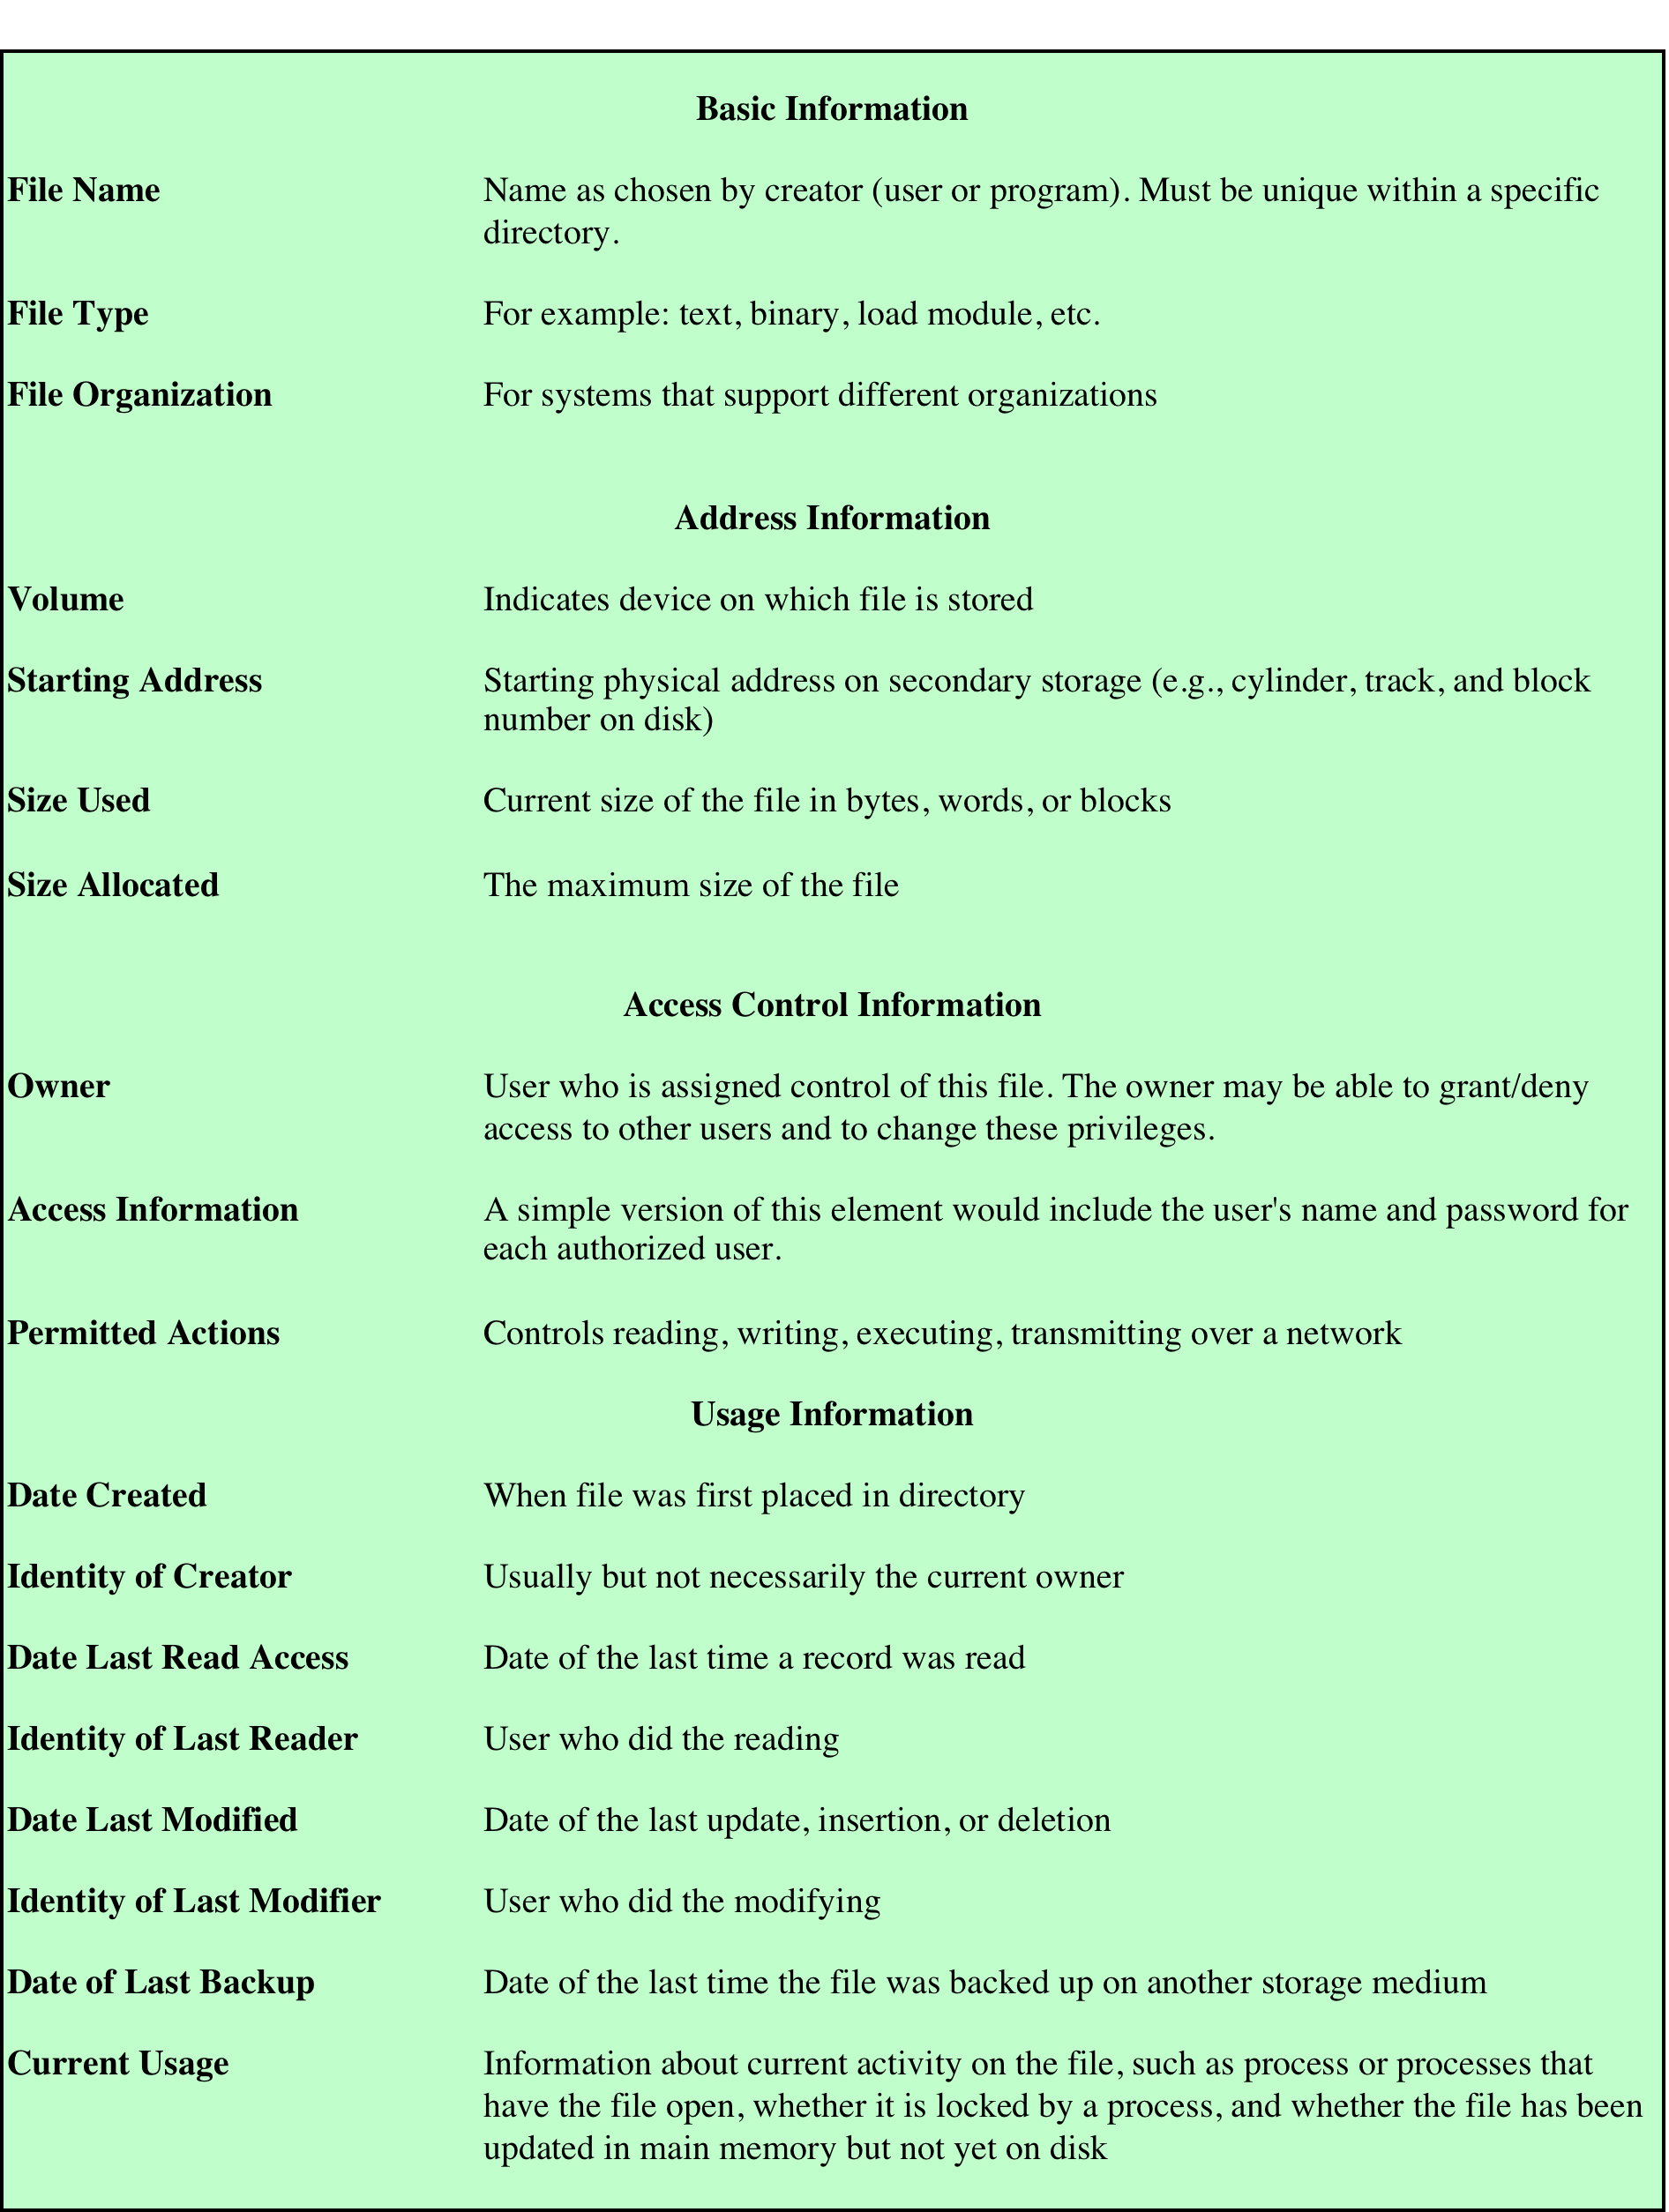
File
Directory
Information
Table 12.2 Information Elements of a File Directory
Notes:
Associated with any file management system and collection of files is a file directory.
The directory contains information about the files, including attributes, location,
and ownership. Much of this information, especially that concerned with storage,
is managed by the operating system. The directory is itself a file, accessible by various
file management routines. Although some of the information in directories is
available to users and applications, this is generally provided indirectly by system
routines.
Table 12.2 suggests the information typically stored in the directory for each
file in the system. From the user’s point of view, the directory provides a mapping
between file names, known to users and applications, and the files themselves. Thus,
each file entry includes the name of the file. Virtually all systems deal with different
types of files and different file organizations, and this information is also provided.
An important category of information about each file concerns its storage, including
its location and size. In shared systems, it is also important to provide information
that is used to control access to the file. Typically, one user is the owner of the file
and may grant certain access privileges to other users. Finally, usage information is
needed to manage the current use of the file and to record the history of its usage.

Slide 15

Operations Performed on a Directory
Search
Create files
Delete files
List directory
Update directory
To understand the requirements for a file structure, it is helpful to consider the types of operations that may be performed on the directory:
Notes:
To understand the requirements for a file structure, it is helpful to consider
the types of operations that may be performed on the directory:
• Search: When a user or application references a file, the directory must be
searched to find the entry corresponding to that file.
• Create file: When a new file is created, an entry must be added to the directory.
• Delete file: When a file is deleted, an entry must be removed from the directory.
• List directory: All or a portion of the directory may be requested. Generally,
this request is made by a user and results in a listing of all files owned by that
user, plus some of the attributes of each file (e.g., type, access control information,
usage information).
• Update directory: Because some file attributes are stored in the directory, a
change in one of these attributes requires a change in the corresponding directory
entry.
The simple list is not suited to supporting these operations. Consider the needs
of a single user. The user may have many types of files, including word-processing
text files, graphic files, spreadsheets, and so on. The user may like to have these
organized by project, by type, or in some other convenient way. If the directory is a
simple sequential list, it provides no help in organizing the files and forces the user
to be careful not to use the same name for two different types of files. The problem
is much worse in a shared system. Unique naming becomes a serious problem.
Furthermore, it is difficult to conceal portions of the overall directory from users
when there is no inherent structure in the directory.

Slide 16
Two-Level Scheme
There is one directory for each user and a master directory
Master directory has an entry for each user directory providing address and access control information
Each user directory is a simple list of the files of that user
Names must be unique only within the collection of files of a single user
File system can easily enforce access restriction on directories
Notes:
A start in solving these problems would be to go to a two-level scheme. In
this case, there is one directory for each user, and a master directory. The master
directory has an entry for each user directory, providing address and access control
information. Each user directory is a simple list of the files of that user. This
arrangement means that names must be unique only within the collection of files
of a single user and that the file system can easily enforce access restriction on
directories. However, it still provides users with no help in structuring collections
of files.

Slide 17
Notes:
A more powerful and flexible approach, and one that is almost universally
adopted, is the hierarchical, or tree-structure, approach ( Figure 12.6 ). As before,
there is a master directory, which has under it a number of user directories. Each of
these user directories, in turn, may have subdirectories and files as entries. This is
true at any level: That is, at any level, a directory may consist of entries for subdirectories
and/or entries for files.
It remains to say how each directory and subdirectory is organized. The simplest
approach, of course, is to store each directory as a sequential file. When directories
may contain a very large number of entries, such an organization may lead to unnecessarily
long search times. In that case, a hashed structure is to be preferred.

Slide 18
Notes:
Users need to be able to refer to a file by a symbolic name. Clearly, each file in the
system must have a unique name in order that file references be unambiguous. On
the other hand, it is an unacceptable burden on users to require that they provide
unique names, especially in a shared system.
The use of a tree-structured directory minimizes the difficulty in assigning
unique names. Any file in the system can be located by following a path from the
root or master directory down various branches until the file is reached. The series
of directory names, culminating in the file name itself, constitutes a pathname for
the file. As an example, the file in the lower left-hand corner of Figure 12.7 . has the
pathname User_B/Word/Unit_A/ABC . The slash is used to delimit names in the
sequence. The name of the master directory is implicit, because all paths start at
that directory. Note that it is perfectly acceptable to have several files with the same
file name, as long as they have unique pathnames, which is equivalent to saying
that the same file name may be used in different directories. In our example, there
is another file in the system with the file name ABC, but that has the pathname
/User_B/Draw/ABC .
Although the pathname facilitates the selection of file names, it would be awkward
for a user to have to spell out the entire pathname every time a reference is
made to a file. Typically, an interactive user or a process has associated with it a
current directory, often referred to as the working directory . Files are then referenced
relative to the working directory. For example, if the working directory for
user B is “Word,” then the pathname Unit_A/ABC is sufficient to identify the file
in the lower left-hand corner of Figure 12.7 . When an interactive user logs on, or
when a process is created, the default for the working directory is the user home
directory. During execution, the user can navigate up or down in the tree to change
to a different working directory.

Slide 19
File Sharing
Two issues arise when allowing files to be shared among a number of users:
Access rights
Management of simultaneous access
Notes:
In a multiuser system, there is almost always a requirement for allowing files to be
shared among a number of users. Two issues arise: access rights and the management
of simultaneous access.

Slide 20
Access Rights
None
  the user would not be allowed to read the user directory that includes the file
  Knowledge
    the user can determine that the file exists and who its owner is and can then petition the owner for additional access rights
  Execution
    the user can load and execute a program but cannot copy it
  Reading
    the user can read the file for any purpose, including copying and execution
Appending
  the user can add data to the file but cannot modify or delete any of the file’s contents
  Updating
  the user can modify, delete, and add to the file’s data
  Changing protection
  the user can change the access rights granted to other users
  Deletion
  the user can delete the file from the file system
Notes:
The file system should provide a flexible tool for allowing extensive file sharing
among users. The file system should provide a number of options so that the way
in which a particular file is accessed can be controlled. Typically, users or groups
of users are granted certain access rights to a file. A wide range of access rights has
been used. The following list is representative of access rights that can be assigned
to a particular user for a particular file:
• None: The user may not even learn of the existence of the file, much less
access it. To enforce this restriction, the user would not be allowed to read the
user directory that includes this file.
• Knowledge: The user can determine that the file exists and who its owner is.
The user is then able to petition the owner for additional access rights.
• Execution: The user can load and execute a program but cannot copy it.
Proprietary programs are often made accessible with this restriction.
• Reading: The user can read the file for any purpose, including copying and
execution. Some systems are able to enforce a distinction between viewing
and copying. In the former case, the contents of the file can be displayed to the
user, but the user has no means for making a copy.
• Appending: The user can add data to the file, often only at the end, but cannot
modify or delete any of the file’s contents. This right is useful in collecting data
from a number of sources.
• Updating: The user can modify, delete, and add to the file’s data. This normally
includes writing the file initially, rewriting it completely or in part, and removing
all or a portion of the data. Some systems distinguish among different
degrees of updating.
• Changing protection: The user can change the access rights granted to other
users. Typically, this right is held only by the owner of the file. In some systems,
the owner can extend this right to others. To prevent abuse of this mechanism,
the file owner will typically be able to specify which rights can be changed by
the holder of this right.
• Deletion: The user can delete the file from the file system.
These rights can be considered to constitute a hierarchy, with each right implying
those that precede it. Thus, if a particular user is granted the updating right for a
particular file, then that user is also granted the following rights: knowledge, execution,
reading, and appending.

Slide 21
User Access Rights
Owner
usually the initial creator of the file
has full rights
may grant rights to others
Specific Users
individual users who are designated by user ID
User Groups
a set of users who are not individually defined
All
all users who have access to this system
these are public files
Notes:
One user is designated as owner of a given file, usually the person who initially
created a file. The owner has all of the access rights listed previously and may grant
rights to others. Access can be provided to different classes of users:
• Specific user: Individual users who are designated by user ID
• User groups: A set of users who are not individually defined. The system must
have some way of keeping track of the membership of user groups.
• All: All users who have access to this system. These are public files.

Slide 22
File Allocation
On secondary storage, a file consists of a collection of blocks
The operating system or file management system is responsible for allocating blocks to files
The approach taken for file allocation may influence the approach taken for free space management
Space is allocated to a file as one or more portions (contiguous set of allocated blocks)
File allocation table (FAT)
    data structure used to keep track of the portions assigned to a file
Notes:
On secondary storage, a file consists of a collection of blocks. The operating system
or file management system is responsible for allocating blocks to files. This raises
two management issues. First, space on secondary storage must be allocated to files,
and second, it is necessary to keep track of the space available for allocation. We
will see that these two tasks are related; that is, the approach taken for file allocation
may influence the approach taken for free space management. Further, we will
see that there is an interaction between file structure and allocation policy.
We begin this section by looking at alternatives for file allocation on a single
disk. Then we look at the issue of free space management, and finally we discuss
reliability.
File Allocation
Several issues are involved in file allocation:
1. When a new file is created, is the maximum space required for the file allocated
at once?
2. Space is allocated to a file as one or more contiguous units, which we shall
refer to as portions. That is, a portion is a contiguous set of allocated blocks.
The size of a portion can range from a single block to the entire file. What size
of portion should be used for file allocation?
3. What sort of data structure or table is used to keep track of the portions
assigned to a file? An example of such a structure is a file allocation table
(FAT) , found on DOS and some other systems.

Slide 23
Preallocation vs
Dynamic Allocation
A preallocation policy requires that the maximum size of a file be declared at the time of the file creation request
For many applications it is difficult to estimate reliably the maximum potential size of the file
    tends to be wasteful because users and application programmers tend to overestimate size
    Dynamic allocation allocates space to a file in portions as needed
Notes:
A preallocation policy requires
that the maximum size of a file be declared at the time of the file creation request.
In a number of cases, such as program compilations, the production of summary
data files, or the transfer of a file from another system over a communications
network, this value can be reliably estimated. However, for many applications, it
is difficult if not impossible to estimate reliably the maximum potential size of the
file. In those cases, users and application programmers would tend to overestimate
file size so as not to run out of space. This clearly is wasteful from the point of view
of secondary storage allocation. Thus, there are advantages to the use of dynamic
allocation, which allocates space to a file in portions as needed.

Slide 24

Portion Size
In choosing a portion size there is a trade-off between efficiency from the point of view of a single file versus overall system efficiency
Items to be considered:
    contiguity of space increases performance, especially for Retrieve_Next operations, and greatly for transactions running in a transaction-oriented operating system
    having a large number of small portions increases the size of tables needed to manage the allocation information
    having fixed-size portions simplifies the reallocation of space
    having variable-size or small fixed-size portions minimizes waste of unused storage due to overallocation
Notes:
The second issue listed is that of the size of the portion allocated to a
file. At one extreme, a portion large enough to hold the entire file is allocated. At the
other extreme, space on the disk is allocated one block at a time. In choosing a portion
size, there is a trade-off between efficiency from the point of view of a single file versus
overall system efficiency. [WIED87] lists four items to be considered in the trade-off:
1. Contiguity of space increases performance, especially for Retrieve_Next
operations, and greatly for transactions running in a transaction-oriented
operating system.
2. Having a large number of small portions increases the size of tables needed to
manage the allocation information.
3. Having fixed-size portions (e.g., blocks) simplifies the reallocation of space.
4. Having variable-size or small fixed-size portions minimizes waste of unused
storage due to overallocation.

Slide 25
Alternatives
Two major alternatives:
Variable, large contiguous portions
Blocks
provides better performance
the variable size avoids waste
the file allocation tables are small
small fixed portions provide greater flexibility
they may require large tables or complex structures for their allocation
contiguity has been abandoned as a primary goal
blocks are allocated as needed
Notes:
Of course, these items interact and must be considered together. The result is
that there are two major alternatives:
• Variable, large contiguous portions: This will provide better performance. The
variable size avoids waste, and the file allocation tables are small. However,
space is hard to reuse.
• Blocks : Small fixed portions provide greater flexibility. They may require
large tables or complex structures for their allocation. Contiguity has been
abandoned as a primary goal; blocks are allocated as needed.
Either option is compatible with preallocation or dynamic allocation. In
the case of variable, large contiguous portions, a file is preallocated one contiguous
group of blocks. This eliminates the need for a file allocation table; all that is
required is a pointer to the first block and the number of blocks allocated. In the
case of blocks, all of the portions required are allocated at one time. This means that
the file allocation table for the file will remain of fixed size, because the number of
blocks allocated is fixed.
With variable-size portions, we need to be concerned with the fragmentation
of free space. This issue was faced when we considered partitioned main memory in
Chapter 7 . The following are possible alternative strategies:
• First fit: Choose the first unused contiguous group of blocks of sufficient size
from a free block list.
• Best fit: Choose the smallest unused group that is of sufficient size.
• Nearest fit: Choose the unused group of sufficient size that is closest to the
previous allocation for the file to increase locality.
It is not clear which strategy is best. The difficulty in modeling alternative
strategies is that so many factors interact, including types of files, pattern of file
access, degree of multiprogramming, other performance factors in the system, disk
caching, disk scheduling, and so on.

Slide 26
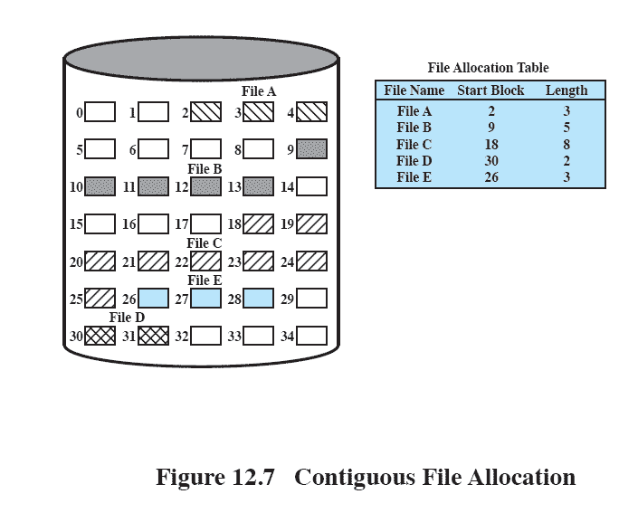
Contiguous File Allocation
A single contiguous set of blocks is allocated to a file at the time of file creation
Preallocation strategy using variable-size portions
Is the best from the point of view of the individual sequential file
12.9
Notes:
With contiguous allocation , a single contiguous set of blocks is allocated to a
file at the time of file creation ( Figure 12.9 ). Thus, this is a preallocation strategy,
using variable-size portions. The file allocation table needs just a single entry for
each file, showing the starting block and the length of the file. Contiguous allocation
is the best from the point of view of the individual sequential file. Multiple blocks
can be read in at a time to improve I/O performance for sequential processing. It is
also easy to retrieve a single block. For example, if a file starts at block b , and the
i th block of the file is wanted, its location on secondary storage is simply b + i – 1.
Contiguous allocation presents some problems. External fragmentation will occur,
making it difficult to find contiguous blocks of space of sufficient length.

Slide 27
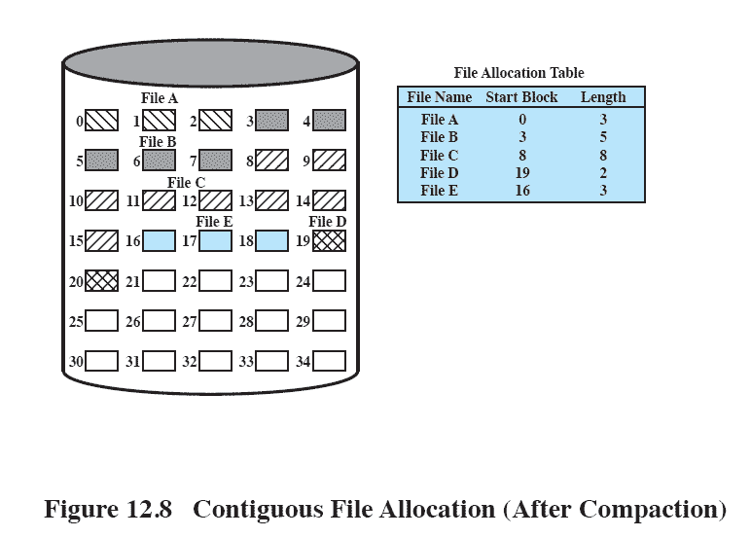
After Compaction
Figure 12.10 Contiguous File Allocation (After Compaction)
Notes:
From time to time, it will be necessary to perform a compaction algorithm to free up additional
space on the disk ( Figure 12.10 ). Also, with preallocation, it is necessary to declare
the size of the file at the time of creation, with the problems mentioned earlier.

Slide 28
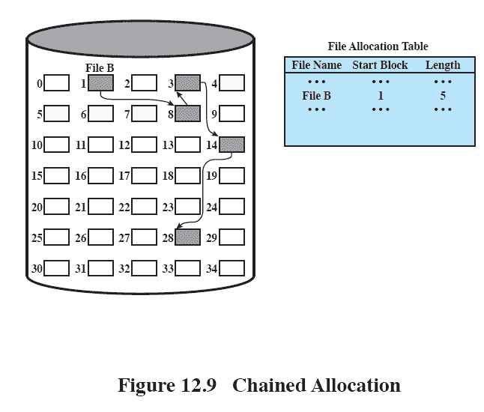
Chained Allocation
Allocation is on an individual block basis
Each block contains a pointer to the next block in the chain
The file allocation table needs just a single entry for each file
No external fragmentation to worry about
Best for sequential files
12.11
Notes:
At the opposite extreme from contiguous allocation is chained allocation
( Figure 12.11 ). Typically, allocation is on an individual block basis. Each block contains
a pointer to the next block in the chain. Again, the file allocation table needs
just a single entry for each file, showing the starting block and the length of the
file. Although preallocation is possible, it is more common simply to allocate blocks
as needed. The selection of blocks is now a simple matter: Any free block can be
added to a chain. There is no external fragmentation to worry about because only
one block at a time is needed. This type of physical organization is best suited to
sequential files that are to be processed sequentially. To select an individual block
of a file requires tracing through the chain to the desired block.

Slide 29
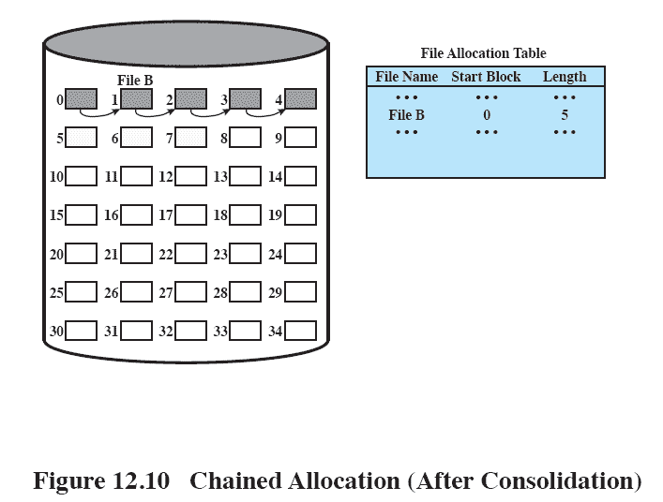
Chained Allocation After Consolidation
12.12
Notes:
One consequence of chaining, as described so far, is that there is no accommodation
of the principle of locality. Thus, if it is necessary to bring in several blocks of
a file at a time, as in sequential processing, then a series of accesses to different parts
of the disk are required. This is perhaps a more significant effect on a single-user
system but may also be of concern on a shared system. To overcome this problem,
some systems periodically consolidate files ( Figure 12.12 ).

Slide 30
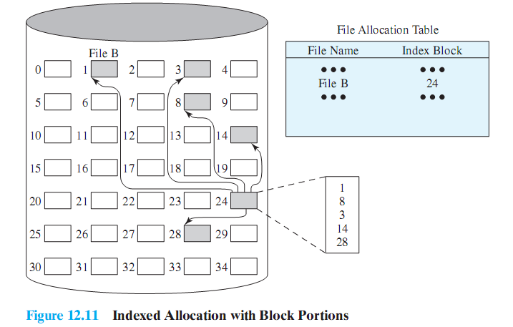
Indexed Allocation with Block Portions
12.13
Notes:
Indexed allocation addresses many of the problems of contiguous and chained
allocation. In this case, the file allocation table contains a separate one-level index for
each file; the index has one entry for each portion allocated to the file. Typically, the
file indexes are not physically stored as part of the file allocation table. Rather, the
file index for a file is kept in a separate block, and the entry for the file in the file allocation
table points to that block. Allocation may be on the basis of either fixed-size
blocks ( Figure 12.13 ) or variable-size portions ( Figure 12.14 ). Allocation by blocks
eliminates external fragmentation, whereas allocation by variable-size portions
improves locality. In either case, file consolidation may be done from time to time.
File consolidation reduces the size of the index in the case of variable-size portions,
but not in the case of block allocation. Indexed allocation supports both sequential
and direct access to the file and thus is the most popular form of file allocation.

Slide 31
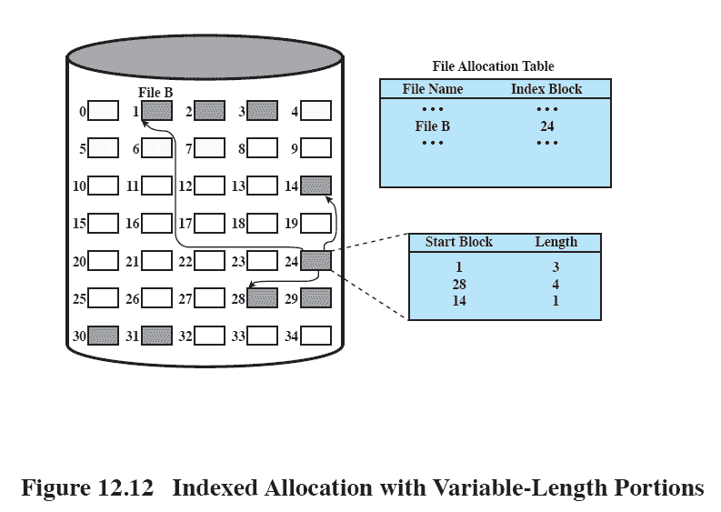
Indexed Allocation with
Variable Length Portions
12.14
Notes:
Figure 12.14 Indexed allocation with Variable-Length Portions

Slide 32
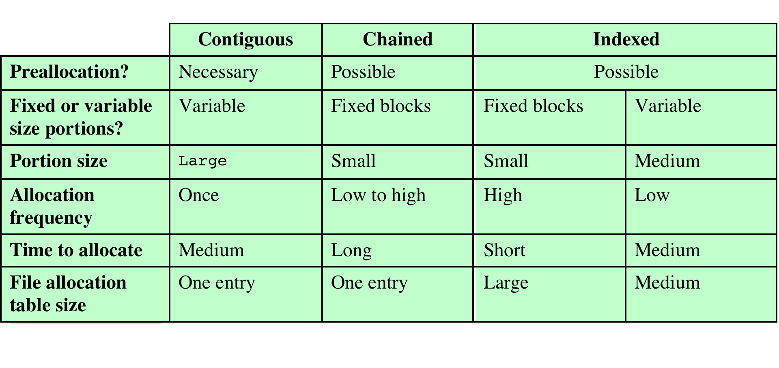
Table 12.3
File Allocation Methods
Notes:
Table 12.3 File Allocation Methods
Having looked at the issues of preallocation versus
dynamic allocation and portion size, we are in a position to consider specific file
allocation methods. Three methods are in common use: contiguous, chained, and
indexed. Table 12.3 summarizes some of the characteristics of each method.

Slide 33
Free Space Management
Just as allocated space must be managed, so must the unallocated space
To perform file allocation, it is necessary to know which blocks are available
A disk allocation table is needed in addition to a file allocation table
Notes:
Just as the space that is allocated to files must be managed, so the space that is not
currently allocated to any file must be managed. To perform any of the file allocation
techniques described previously, it is necessary to know what blocks on the disk
are available. Thus we need a disk allocation table in addition to a file allocation
table. We discuss here a number of techniques that have been implemented.

Slide 34
Bit Tables
This method uses a vector containing one bit for each block on the disk
Each entry of a 0 corresponds to a free block, and each 1 corresponds to a block in use
Advantages:
works well with any file allocation method
it is as small as possible
Notes:
This method uses a vector containing one bit for each block on the
disk. Each entry of a 0 corresponds to a free block, and each 1 corresponds to a
block in use. For example, for the disk layout of Figure 12.9 , a vector of length 35 is
needed and would have the following value:
00111000011111000011111111111011000
A bit table has the advantage that it is relatively easy to find one or a contiguous
group of free blocks. Thus, a bit table works well with any of the file
allocation methods outlined. Another advantage is that it is as small as possible.
However, it can still be sizable. The amount of memory (in bytes) required for a
block bitmap is
disk size in bytes/
8 * file system block size
Thus, for a 16-Gbyte disk with 512-byte blocks, the bit table occupies about
4 Mbytes. Can we spare 4 Mbytes of main memory for the bit table? If so, then the
bit table can be searched without the need for disk access. But even with today’s
memory sizes, 4 Mbytes is a hefty chunk of main memory to devote to a single function.
The alternative is to put the bit table on disk. But a 4-Mbyte bit table would
require about 8,000 disk blocks. We can’t afford to search that amount of disk space
every time a block is needed, so a bit table resident in memory is indicated.
Even when the bit table is in main memory, an exhaustive search of the table
can slow file system performance to an unacceptable degree. This is especially true
when the disk is nearly full and there are few free blocks remaining. Accordingly,
most file systems that use bit tables maintain auxiliary data structures that summarize
the contents of subranges of the bit table. For example, the table could be
divided logically into a number of equal-size subranges. A summary table could
include, for each subrange, the number of free blocks and the maximum-sized contiguous
number of free blocks. When the file system needs a number of contiguous
blocks, it can scan the summary table to find an appropriate subrange and then
search that subrange.

Slide 35
Chained Free Portions
The free portions may be chained together by using a pointer and length value in each free portion
Negligible space overhead because there is no need for a disk allocation table
Suited to all file allocation methods
Disadvantages:
leads to fragmentation
every time you allocate a block you need to read the block first to recover the pointer to the new first free block before writing data to that block
Notes:
The free portions may be chained together by using
a pointer and length value in each free portion. This method has negligible space
overhead because there is no need for a disk allocation table, merely for a pointer to
the beginning of the chain and the length of the first portion. This method is suited
to all of the file allocation methods. If allocation is a block at a time, simply choose
the free block at the head of the chain and adjust the first pointer or length value.
If allocation is by variable-length portion, a first-fit algorithm may be used: The
headers from the portions are fetched one at a time to determine the next suitable
free portion in the chain. Again, pointer and length values are adjusted.
This method has its own problems. After some use, the disk will become quite
fragmented and many portions will be a single block long. Also note that every
time you allocate a block, you need to read the block first to recover the pointer to
the new first free block before writing data to that block. If many individual blocks
need to be allocated at one time for a file operation, this greatly slows file creation.
Similarly, deleting highly fragmented files is very time consuming.

Slide 36
Indexing
Treats free space as a file and uses an index table as it would for file allocation
For efficiency, the index should be on the basis of variable-size portions rather than blocks
This approach provides efficient support for all of the file allocation methods
Notes:
The indexing approach treats free space as a file and uses an index table
as described under file allocation. For efficiency, the index should be on the basis
of variable-size portions rather than blocks. Thus, there is one entry in the table for
every free portion on the disk. This approach provides efficient support for all of
the file allocation methods.

Slide 37
Volumes
A collection of addressable sectors in secondary memory that an OS or application can use for data storage
The sectors in a volume need not be consecutive on a physical storage device
    They need only appear that way to the OS or application
A volume may be the result of assembling and merging smaller volumes
Notes:
The term volume is used somewhat differently by different operating systems and
file management systems, but in essence a volume is a logical disk. [CARR05]
defines a volume as follows:
Volume: A collection of addressable sectors in secondary memory that an OS or
application can use for data storage. The sectors in a volume need not be consecutive
on a physical storage device; instead, they need only appear that way to
the OS or application. A volume may be the result of assembling and merging
smaller volumes.
In the simplest case, a single disk equals one volume. Frequently, a disk is
divided into partitions, with each partition functioning as a separate volume. It is
also common to treat multiple disks as a single volume or partitions on multiple
disks as a single volume.

Slide 38
Summary
A file management system:
  is a set of system software that provides services to users and applications in the use of files
  is typically viewed as a system service that is served by the operating system
Files:
  consist of a collection of records
  if a file is primarily to be processed as a whole, a sequential file organization is the simplest and most appropriate
  if sequential access is needed but random access to individual file is also desired, an indexed sequential file may give the best performance
  if access to the file is principally at random, then an indexed file or hashed file may be the most appropriate
  directory service allows files to be organized in a hierarchical fashion
Some sort of blocking strategy is needed
Key function of file management scheme is the management of disk space
  strategy for allocating disk blocks to a file
  maintaining a disk allocation table indicating which blocks are free
Notes:
A file management system is a set of system software that provides services to users
and applications in the use of files, including file access, directory maintenance, and
access control. The file management system is typically viewed as a system service
that itself is served by the operating system, rather than being part of the operating
system itself. However, in any system, at least part of the file management function
is performed by the operating system.
A file consists of a collection of records. The way in which these records may
be accessed determines its logical organization, and to some extent its physical organization
on disk. If a file is primarily to be processed as a whole, then a sequential
file organization is the simplest and most appropriate. If sequential access is needed
but random access to individual file is also desired, then an indexed sequential file
may give the best performance. If access to the file is principally at random, then an
indexed file or hashed file may be the most appropriate.
Whatever file structure is chosen, a directory service is also needed. This
allows files to be organized in a hierarchical fashion. This organization is useful to
the user in keeping track of files and is useful to the file management system in providing
access control and other services to users.
File records, even when of fixed size, generally do not conform to the size of a
physical disk block. Accordingly, some sort of blocking strategy is needed. A tradeoff
among complexity, performance, and space utilization determines the blocking
strategy to be used.
A key function of any file management scheme is the management of disk
space. Part of this function is the strategy for allocating disk blocks to a file. A variety
of methods have been employed, and a variety of data structures have been used
to keep track of the allocation for each file. In addition, the space on disk that has
not been allocated must be managed. This latter function primarily consists of maintaining
a disk allocation table indicating which blocks are free.

