Slide 1

EE x12
Technical Reports Writing
Lecture 7
Dr. Essam Sourour
Faculty of Engineering
Alexandria University

Slide 2
Chapter 5
Writing Common Engineering Documents

Slide 3
Outline
Common Documents
Preliminaries
Inspection and Business Trip Reports
Research, Laboratory, or Field Reports
Specifications
Proposals
Progress Reports
Instructions
Recommendation Reports

Slide 4
Some Common Documents
Inspection or trip reports
Research, laboratory, and field reports
Specifications
Proposals
Progress reports
Instructions
Recommendation and feasibility reports

Slide 5
Preliminaries
Find out your company’s requirements.
  Specific format and organization
Think creatively about content and organization.
  Brainstorm about what you want to write and how
Address the needs of your audience.
  Make sure the document provides their needs
Be careful with discussion of technical background.
  Attention to background section based on the expected readers
Carefully craft with the report introduction.
  Topics covered and why they are important
Prepare for the media.
  print, web site, social media.

Slide 6
Inspection and Business Trip Reports
Could be for inspection report, site reports, accident reports, investigative reports.
May include:
  Introduction: purpose of report and overview of content
  Background
  Discussion for main contents
  Actions taken to solve a problem
  Recommendations

Slide 7
Research, Laboratory, or Field Reports
Presenting data, experiments, survey, theory or method
May include:
  Abstract
  Introduction
  Background
  Literature review
  Theory, method, procedure, or equipment
  Observations, data, findings, and results
  Figures, illustrations, curves, lists and tables
  Conclusions
  Implications and further research
  References and information sources

Slide 8
Specifications
Specifications may provide requirements for jobs, tasks, services, materials, etc.
Specifications may provide exact technical description of product, equipment, material, etc.
May be in text format or table format (data sheets)
Focus on accuracy and clarity and precision of details
Should include information about the authority and authors
Traditional specifications use “shall” to indicate requirements
Extra caution should be taken to make sure meanings are precise

Slide 9
Proposals
Types: solicited, unsolicited; external, internal
Solicited proposals usually have special formats and contents requirements
Proposals may include:
  Introduction
  Background: need, opportunity
  Proposed project
  Description of the project
  Benefits, feasibility
  Method, approach
  SWOT analysis
  Qualifications of team (proposer’s)
  Schedule (and Gantt chart, MS Project)
  Budget details and costs
  Conclusion

Slide 10
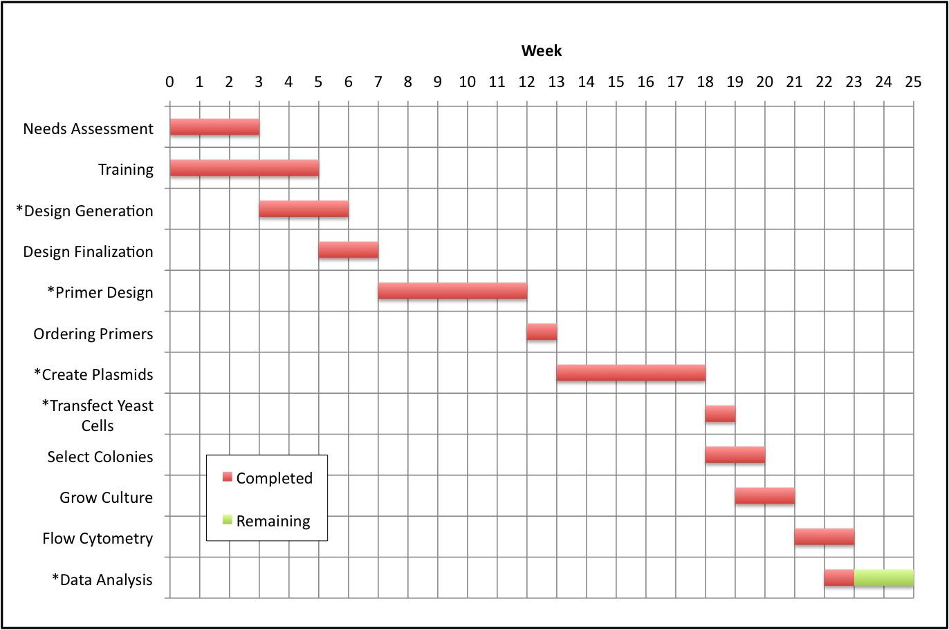
Example Gantt Chart

Slide 11
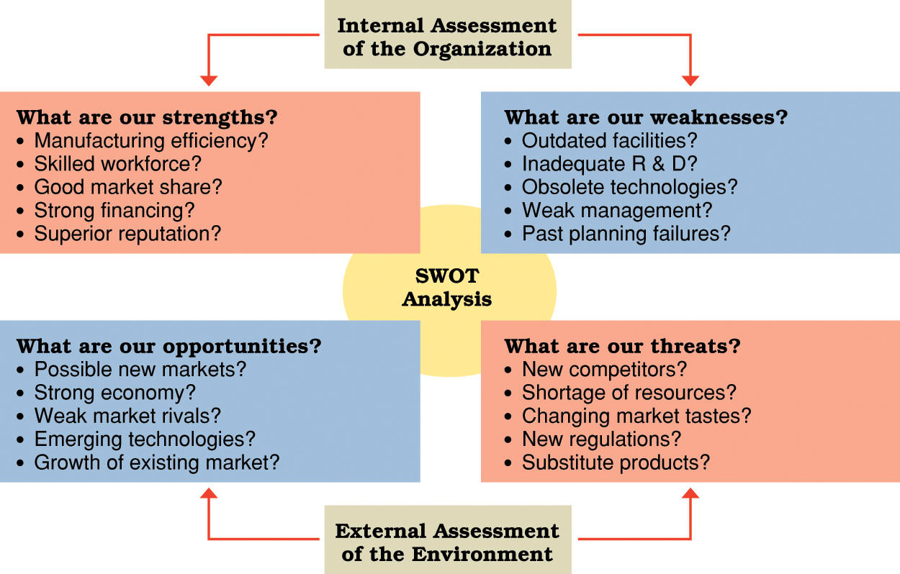
SWOT Analysis

Slide 12
Progress Reports
Engineers may have to write progress or status reports periodically about their projects
Could be for the clients, supervisors or funding source
Progress report may include:
  Introduction
  Project description
  Progress summary
    Tasks completed, underway, planned
    Time table
  Problems encountered
  Changes in requirements (if any)
  Overall project assessment
  Conclusion

Slide 13
Instructions
Step-by-step procedures for some engineering task
Put yourself in the reader’s place when implementing them
May include:
  Introduction: what is being done and who may do it
  Background: if needed to understand the procedures
  Special notes: attentions, cautions, danger
  Equipment, tools and supplies needed
  Discussion of steps
    Lists
    Figures and graphics
    Headings and lists as needed
    Special format to emphasize points (bold, italic, underline, or colors)

Slide 14
Recommendation Reports
Recommendation about plans, products, people, etc.
Compares options against each other
Compares projects/programs against requirements/costs
May include:
  Introduction
  Background: problem, opportunity
  Requirements
  Technical background
  Description of the options
  Point-by-point comparisons
  Summary table
  Conclusions
  Recommendation
  References and information sources

