Slide 1

EE x12
Technical Reports Writing
Lecture 8
Dr. Essam Sourour
Faculty of Engineering
Alexandria University

Slide 2
Chapter 10
Writing to Get an Engineering Job

Slide 3
Outline
Resume or CV, (Curriculum Vitae)
Cover letter

Slide 4
What is a Resume
Resume is a summary of your
  Professional experience
  Education
  Background relevant to employment
Employer can glance it for 30 seconds and still get a good idea about your qualifications
Consider a work in progress: update it every accomplishment in your professional life

Slide 5
Design Approaches
Resume can be designed with two approaches:
  Chronological approach (i.e., ordered in time)
  Functional approach
Chronological approach is typically preferred for early career

Slide 6
Chronological Approach
Better for new graduates and early career
Resume divided into time progress
Education:
  What studied (B.Sc. Electrical Engineering, Electronics and Communications)
  Where (University)
  From, to
  Over all grade and selected subjects related to job
Work experience, newest first
  Projects or responsibilities in each company or organization
Disadvantage: not providing an integrated idea about experiences
Solution: add a highlights section at the top

Slide 7
Functional Approach
Resume divided into functions
Collect information about key qualifications
Example: you may have a section of “Project Management”:
  Courses attended and grades
  Seminars attended or given in management
  Roles in management in different companies you worked at
Example: you may have a section of “Electronic Design”:
  Courses in electronics and their grades
  Projects in electronics and their grades
  Work experience(s) in electronics design, maintenance, troubleshooting at different jobs
Disadvantage: No time progress is immediately clear
Solution: Short education and experience section without details

Slide 8
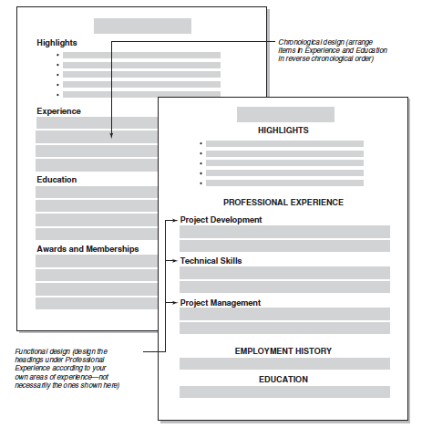
Chronological
Functional

Slide 9
Design Components
Objectives Section:
  Two or 3 lines at most
  Work you want to do, position to seek, organization to work for
  It should be somewhat specific, not just nice words
  It should be tailored for each employer
Weak example of objectives section:
  Seeking a challenging rewarding career with a dynamic upscale company where I will have ample room for professional and personal growth.
Good example of objectives section:
  Electrical engineer seeking position in electronic design using hardware CPLDs and FPGAs or programming microcontrollers and DSPs in a multinational organization where I can convert design plans into working products.

Slide 10
Design Components, cont.
Highlights Section:
  Also called “Summary of Experience,” “Summary,” “Highlights of Experience,” “Summary of Qualifications,” “Professional Expertise,” etc.
  Summary of key educations, qualifications, accomplishments, languages and consolidated experiences
  Can be divided in several bullets
  Solve the weakness of chronological approach
Membership and Licenses section:
  Relevant professional organizations membership (IEEE for example) and relevant licenses
Specialized equipment and knowledge section:
  Any special hardware or software that you have experience with

Slide 11
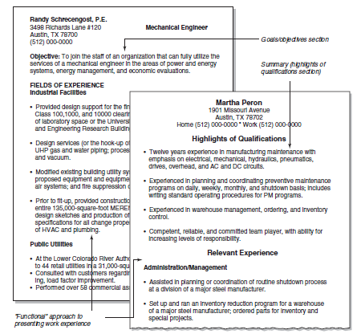
Objectives and Highlights sections

Slide 12
Design Components, cont.
Education and Experience section:
  Bulk of resume
  Chronological or functional approach
Personal section:
  Hobbies, activities, sports, etc.
  Brief information showing you are a nice human being
Other sections:
  Honors and Awards
  Publications, patents, reports
  Any other relevant information. Do not miss any thing.

Slide 13
Presentation of Details
Each section in resume should have a clear title, easily seen
Present you education and experience in bulleted list or short paragraphs
Highlight the name of organizations you worked for your titles and positions (bold case, separate lines, bold face, etc.)
Show off your best qualifications

Slide 14
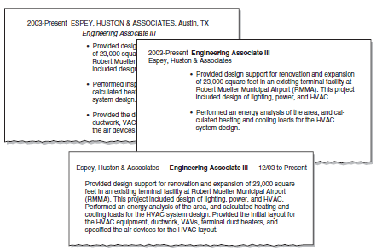
Presentation of Details, cont

Slide 15
Education Section
Name, location, and brief description of University
Dates of enrollment and graduation
Your major and minors, grade (overall and in your major)
Major emphasis of study
Important courses taken with descriptions and grades
Experience with technologies, equipment, and processes
Important projects
Awards, memberships

Slide 16
Experience Sections
Name of the organization where you worked and its address
Brief description of the organization, its products, services
Your job title and your specific responsibilities
Dates of employment with the organization
Your major achievements, important projects, promotions, and awards
Experience with technologies, equipment, and processes at that organization

Slide 17
Overall Format
Use strong words like: designed, developed, utilized, coordinated, and supervised
Use full pages as much as possible. Do not keep a page with few lines
Do not make the resume unnecessary long
Pages should be numbered
Do not write “Resume” as the title. Write your name and contact information
Prepare your resume electronically in PDF format

Slide 18
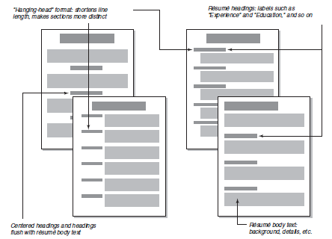
Several Possible Formats

Slide 19
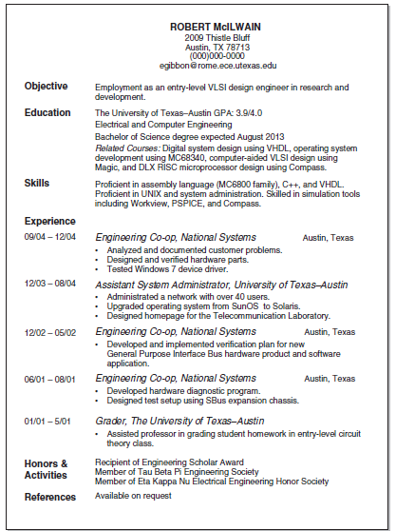
Example Resume (1 page)

Slide 20
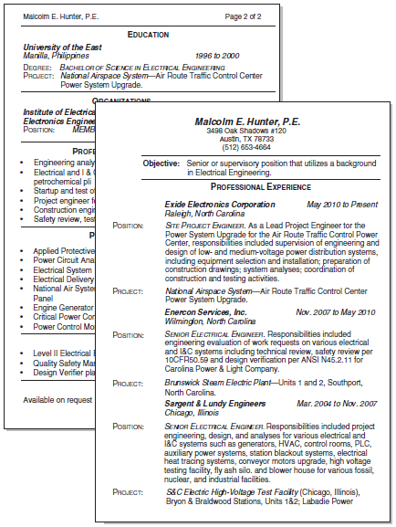
Example Resume (2 pages)

Slide 21
Cover Letter
Some employers require a cover letter with the resume
If they do not decide resume only, send both
Typical cover letter include 3 paragraphs
First Paragraph:
  Purpose of letter (to apply for specific job)
  How you found about the opening
  Something specific about your qualifications that relates to the opening
  Something about the company that relates to your experience, showing that you are informed about the job you seek
  If applicable, name of someone you know in the company who may speak in your favor

Slide 22
Cover Letter, cont
Middle Paragraph:
  Briefly present your qualifications and relate them directly to the job opening and the company’s business
  Chronological or functional (as mentioned before)
  Start with the most related to the company or job
  Use bullets if needed to summarize your experience
Final Paragraph:
  Mention that your attached resume shows the details
  Ask the employer to call or email you for any additional information
  Mention you are ready for interview
  Mention you are strongly interested to work for this company

Slide 23
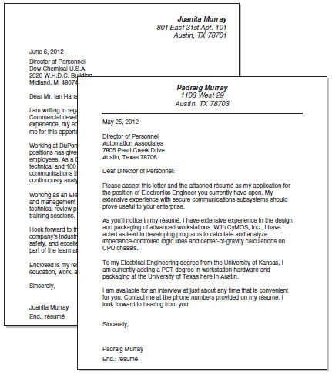
Example Cover Letters

Slide 24
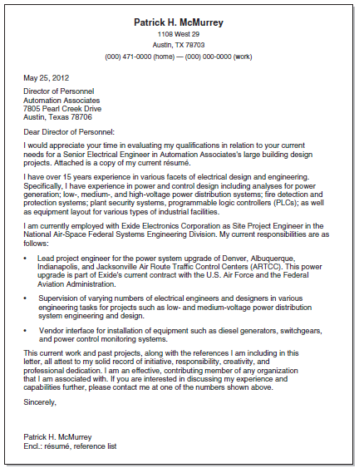
Example Cover Letters, cont.

Slide 25
Homework
Write your resume and cover letter:
Resume must include:
  Name and contact information
  Objective
  Professional highlights
  Education
  Experience
  All in one page
Cover letter must include
  Three paragraphs as explained in the lecture
Follow all technical writing guidelines

